Slide 1
To Stock or not to stock
Patrick Du, Kiseok Yang, Chuanyao Lin
Notes:
Hi, this is Group8, patrick, kiseok and yao responsible for to stock or not to stock (15 sec)

Slide 2


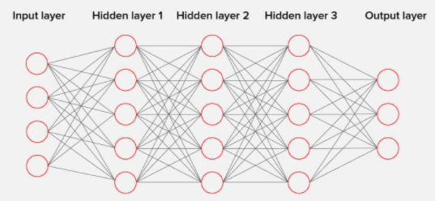
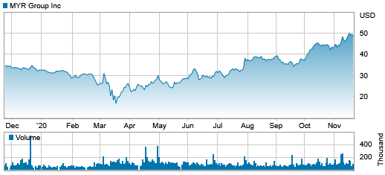
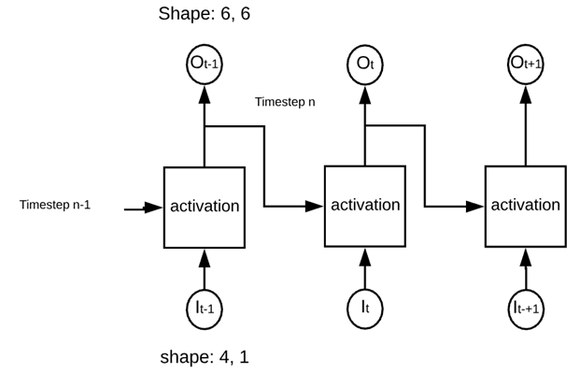
Description/Goals
Notes:
Our goal is to predict next day stock price accurately with analyzing fundamental and news data (10sec)

Slide 3
Roles
Patrick
Sentiment Analysis
Yao
Feature Selection
Kiseok
Prediction by LSTM model

Slide 4
Approach
Sentiment Analysis
SVM-Based Feature Selection
LSTM

Slide 5


Sentiment Analysis
-Web scrape from Twitter an Finviz.com
-Training data is labeled 0 or 1 (negative/ positive sentiment)
-Use Lemmatization and clean text to convert to n-grams
-Feed to classifier (Logistic Regression vs Gaussian Naive Bayes)

Slide 6
SVM-based Feature Selection
Feature sensitivity
-The ability of features to influences the output.
-The absolute value of each feature’s weight based on the linear kernel SVM.
SVM-RFE(Recursive Feature Elimination)
-pruned the least important features recursively
until the desired number of features we set.

Slide 7
SVM-based Feature Selection
Date,Open,High,Low,Close,Adj Close,Volume
↓(through mathematical formulations )
7 DAYS MA, 14 DAYS MA, 21 DAYS MA, 7 DAYS STD DEV, RSI, 10 DAYS EMA, 20 DAYS EMA, MACD, 6 DAYS PSY, 24 DAYS AR, 6 DAYS WMS
↓(SVM-RFE )
Features | 7 DAYS MA | 14 DAYS MA | 21 DAYS MA | 7 DAYS STD DEV | RSI | 10 DAYS EMA | 20 DAYS EMA | MACD | 6 DAYS PSY | 24 DAYS AR | 6 DAYS WMS
Ranking | 3 | 8 | 6 | 1 | 4 | 5 | 10 | 7 | 9 | 11 | 2
Features | 7 DAYS MA | 14 DAYS MA | 21 DAYS MA | 7 DAYS STD DEV | RSI | 10 DAYS EMA | 20 DAYS EMA | MACD | 6 DAYS PSY | 24 DAYS AR | 6 DAYS WMS
Ranking | 3 | 8 | 6 | 1 | 4 | 5 | 10 | 7 | 9 | 11 | 2
↓(Correlation-based clustering )
7 DAYS MA | 14 DAYS MA | 21 DAYS MA | 10 DAYS EMA | 7 DAYS STD DEV | 20 DAYS EMA
7 DAYS MA | 14 DAYS MA | 21 DAYS MA | 10 DAYS EMA | 7 DAYS STD DEV | 20 DAYS EMA
RSI | 24 DAYS AR | MACD | 6 DAYS PSY
RSI | 24 DAYS AR | MACD | 6 DAYS PSY
6 DAYS WMS
6 DAYS WMS

Slide 8
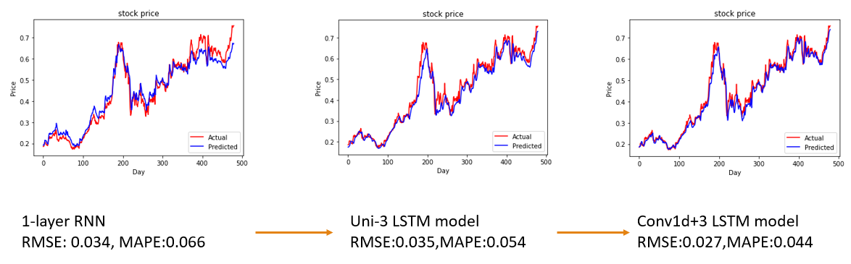
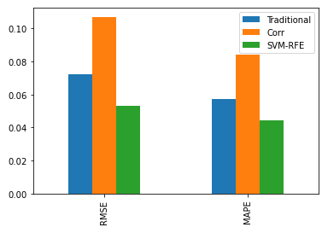
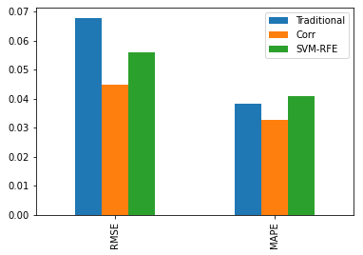
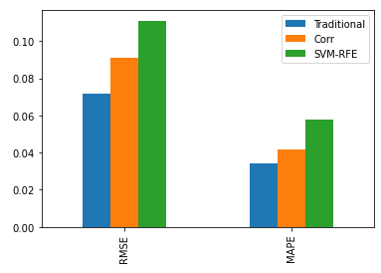
Experiments/Evaluation
NVDA
INTC
MSFT
Notes:
Compare to other algorithms, LSTM model has better performance and bi-directional LSTM with Conv layer works the best.
The feature selection with SVM-RFE does have good performance, like NVDA, but in general, it does not have optimal results

Slide 9
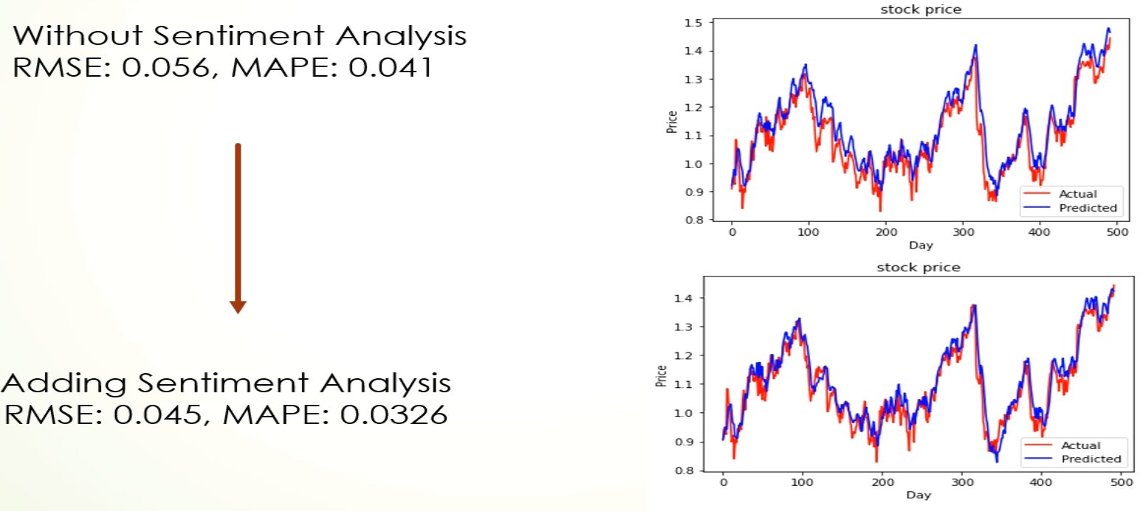
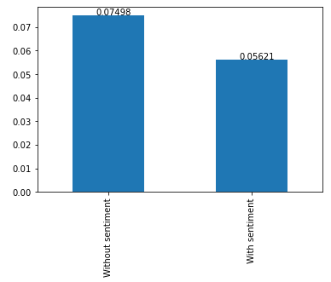
Experiments/Evaluation
Notes:
Applying sentiment analysis, it does have improved the performance with sentiment analysis from 0.056 to 0.045 RMSE.

Slide 10
Discussion/Conclusions
LSTM model improvement (About 26.5%)
With Sentient Analysis Improvement (about 25%)
Feature Selection by SVM-RFE -> Improved in certain companies, but not in General. -> Feature Selection by Non-Linear Classifiers

Slide 11
ML topics related to the Study
GNB/Logistic Regression
Scraping news headlines and labeling them.
applying sentiment analysis on training data and real data
ANN
LSTM for long sequential data analysis, like stock price prediction or text classification
SVM
learned more about how those parameters work, and what exact meanings reflect to the dataset when training the SVM model.

Slide 12
Challenges
Linear vs Non-Linear
The diversity of the dataset
Customization Models
Detecting Neutral Sentiments in validation set
Breaking a sentence into core sentiments

Slide 13
State-of-the-art/Related Work
Taewook Kim, Ha Young Kim.(2019) “Forecasting stock prices with a feature fusion LSTM-CNN model using different representations of the same data”, PLOS ONE
Journals,
Mehtab, S., Sen, J., Dutta, A. (2020). “Stock Price Prediction Using Machine Learning and LSTM-Based Deep Learning Models”. Conference: Second Symposium on Machine
Learning and Metaheuristic Algorithms and Applications (SOMMA'20) at: Vellore Institute of Technology, Chennai, INDIA.
Nelson, D.M.Q.; Pereira, A.C.M.; de Oliveira, R.A. Stock market’s price movement prediction with LSTM neural networks. In Proceedings of the 2017 International Joint
Conference on Neural Networks (IJCNN), Anchorage, AK, USA, 14–19 May 2017.
B. Li, Q. Wang, and J. Hu, “Feature subset selection: A correlation based SVM filter approach,” IEEJ Trans. on Electrical and Electronic Engineering, vol. 6, no. 2, pp.
173–179, March 2011.
Shen, S., Jiang, H., & Zhang, T. Stock Market Forecasting Using Machine Learning Algorithms.
http://cs229.stanford.edu/proj2012/ShenJiangZhang-StockMarketForecastingusingMachineLearningAlgorithms.pdf.
Kalyanaraman, V., Kazi, S., Tondulkar, R., & Oswal, S. (2014). Sentiment Analysis on News Articles for Stocks. Sentiment Analysis on News Articles for Stocks - IEEE
Conference Publication. https://ieeexplore.ieee.org/document/7079267.

Slide 14
Thank You

